Slide 1
22-3 UNICAST ROUTING PROTOCOLS
A routing table can be either static or dynamic. A static table is one with manual entries. A dynamic table is one that is updated automatically when there is a change somewhere in the Internet. A routing protocol is a combination of rules and procedures that lets routers in the Internet inform each other of changes.
Topics discussed in this section:
Optimization
Intra- and Interdomain Routing
Distance Vector Routing and RIP
Link State Routing and OSPF
Path Vector Routing and BGP
22.<number>

Slide 2

Figure 22.12 Autonomous systems
22.<number>

Slide 3

Figure 22.13 Popular routing protocols
22.<number>

Slide 4

Figure 22.14 Distance vector routing tables
22.<number>

Slide 5

Figure 22.15 Initialization of tables in distance vector routing
22.<number>

Slide 6

Note
In distance vector routing, each node shares its routing table with its
immediate neighbors periodically and when there is a change.
22.<number>

Slide 7

Figure 22.16 Updating in distance vector routing
22.<number>

Slide 8

Figure 22.17 Two-node instability
22.<number>

Slide 9
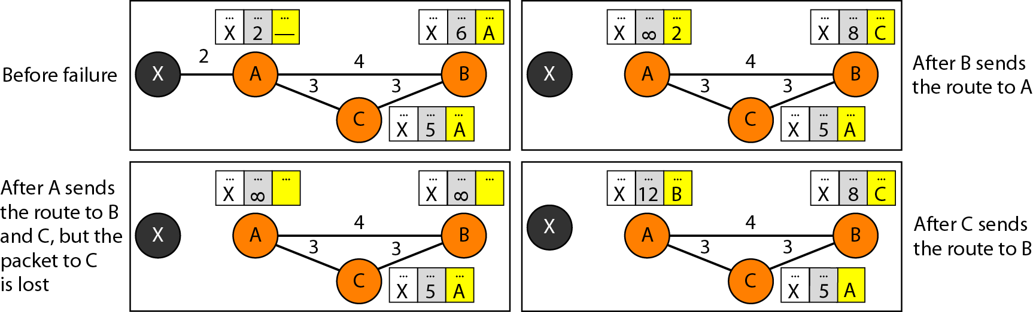
Figure 22.18 Three-node instability
22.<number>

Slide 10

Figure 22.19 Example of a domain using RIP
22.<number>

Slide 11

Figure 22.20 Concept of link state routing
22.<number>

Slide 12

Figure 22.21 Link state knowledge
22.<number>

Slide 13

Figure 22.22 Dijkstra algorithm
22.<number>

Slide 14

Figure 22.23 Example of formation of shortest path tree
22.<number>

Slide 15

Table 22.2 Routing table for node A
22.<number>

Slide 16

Figure 22.24 Areas in an autonomous system
22.<number>

Slide 17
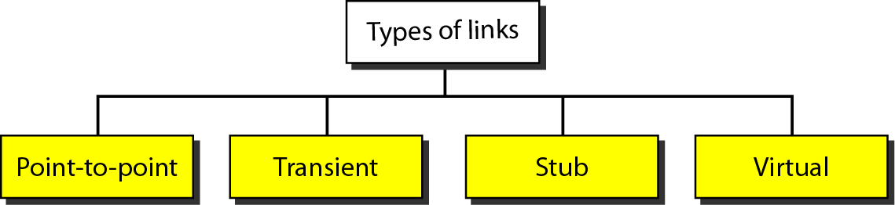
Figure 22.25 Types of links
22.<number>

Slide 18
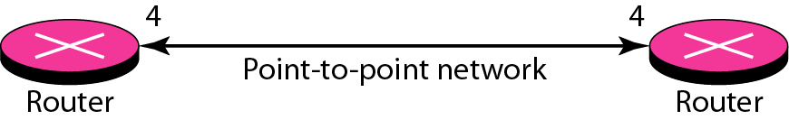
Figure 22.26 Point-to-point link
22.<number>

Slide 19
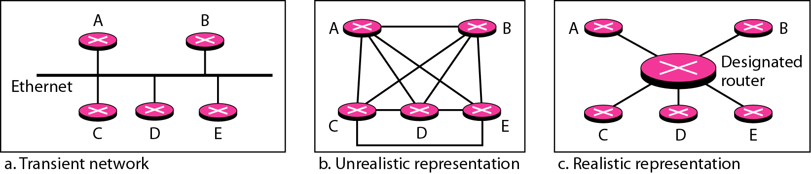
Figure 22.27 Transient link
22.<number>

Slide 20
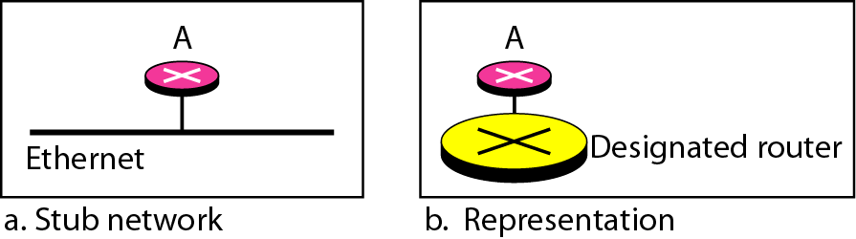
Figure 22.28 Stub link
22.<number>

Slide 21
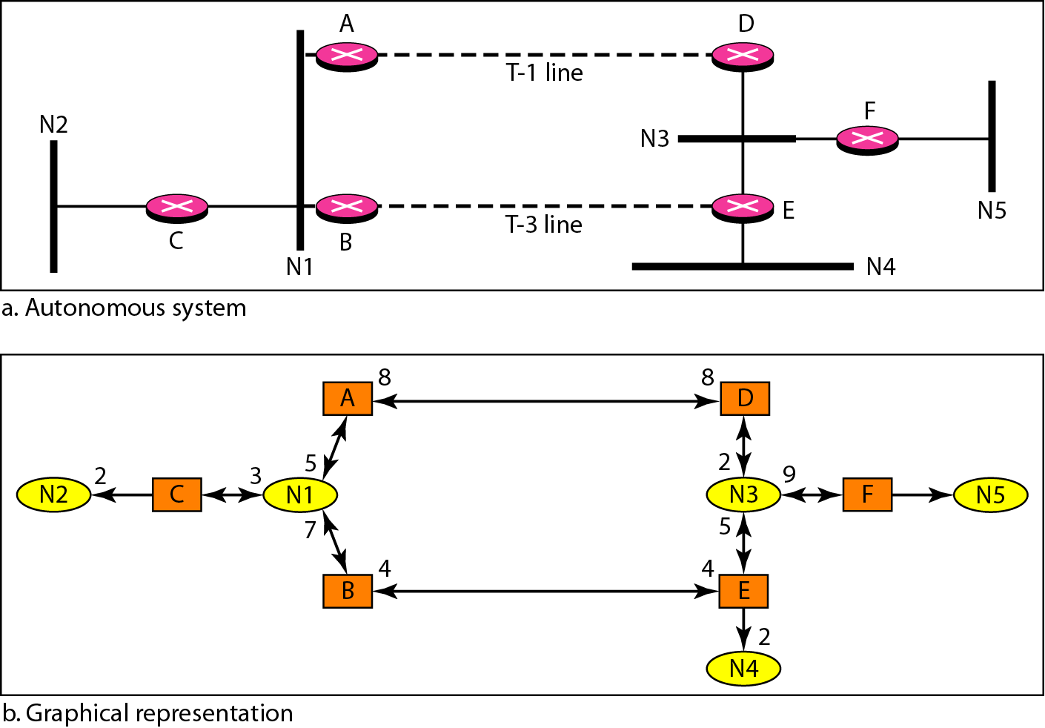
Figure 22.29 Example of an AS and its graphical representation in OSPF
22.<number>

Slide 22
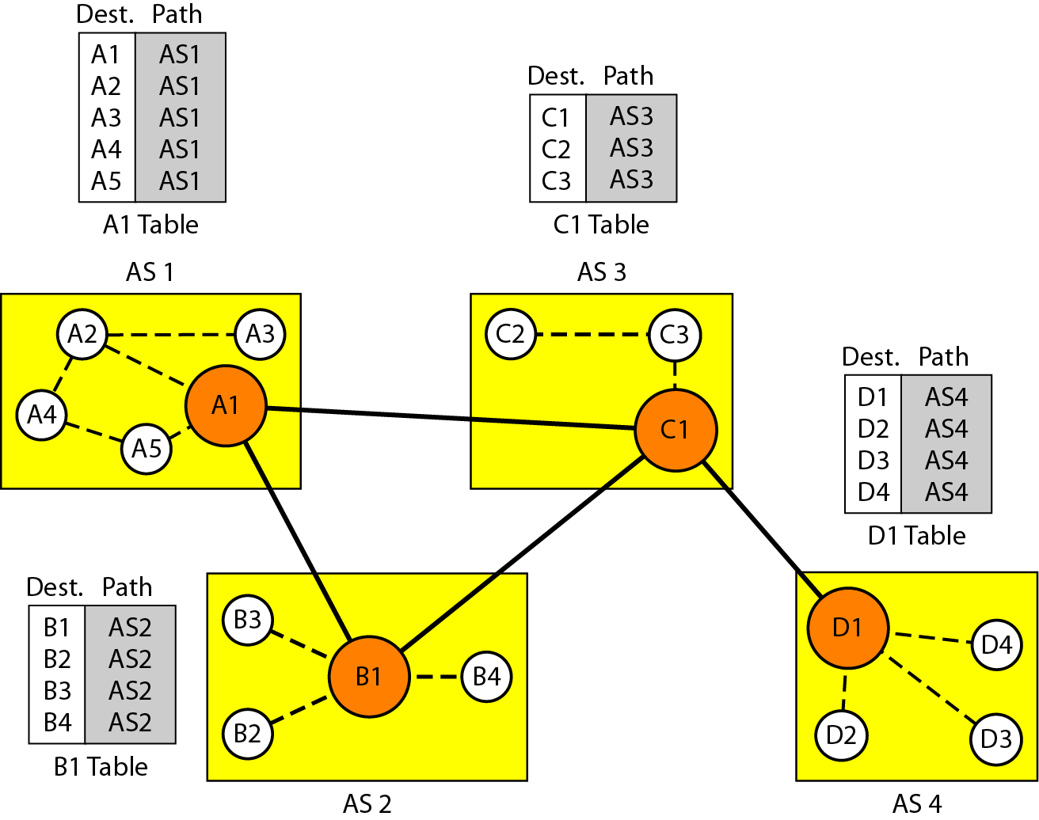
Figure 22.30 Initial routing tables in path vector routing
22.<number>

Slide 23
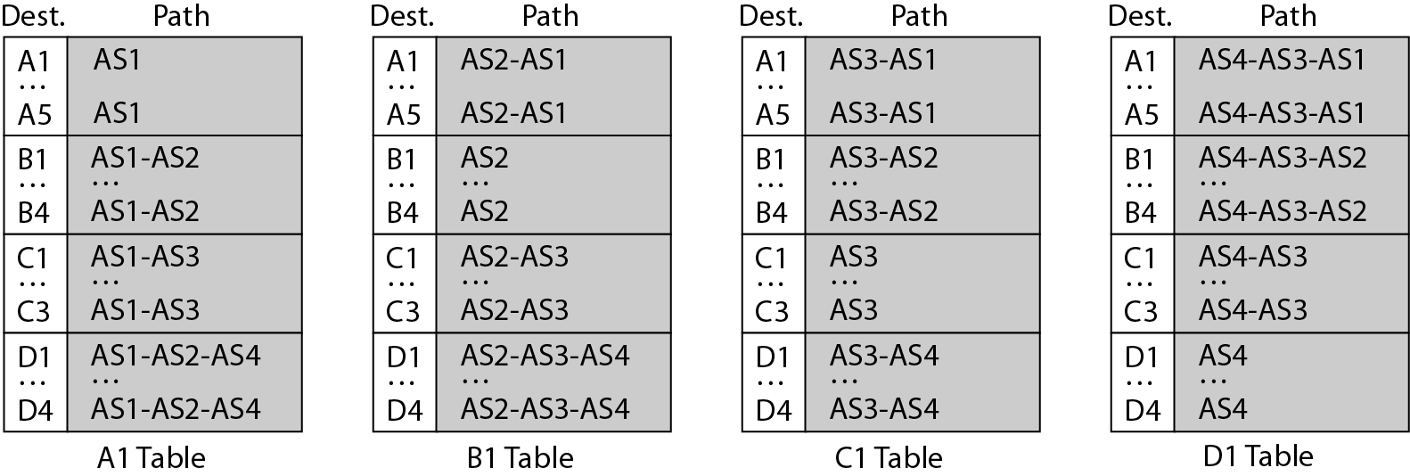
Figure 22.31 Stabilized tables for three autonomous systems
22.<number>

Slide 24
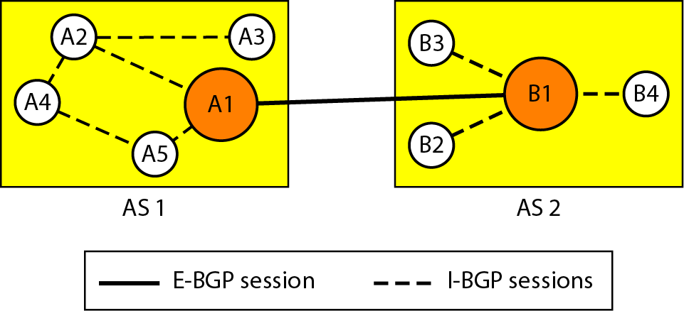
Figure 22.32 Internal and external BGP sessions
22.<number>

